Slide 1

Descriptive Statistics: Measures of Dispersion
14

Slide 2
Measures of Dispersion
Key to understanding variability within data
Helps assess the spread of data points around the central value
Crucial for determining data consistency and model performance
Used to detect outliers and understand data distribution
Essential for model selection, data preprocessing, and risk assessment
15

Slide 3
Measures of Dispersion
Range: Max value - Min value
Variance: Average squared deviation from the mean
Standard Deviation: Square root of variance
16

Slide 4
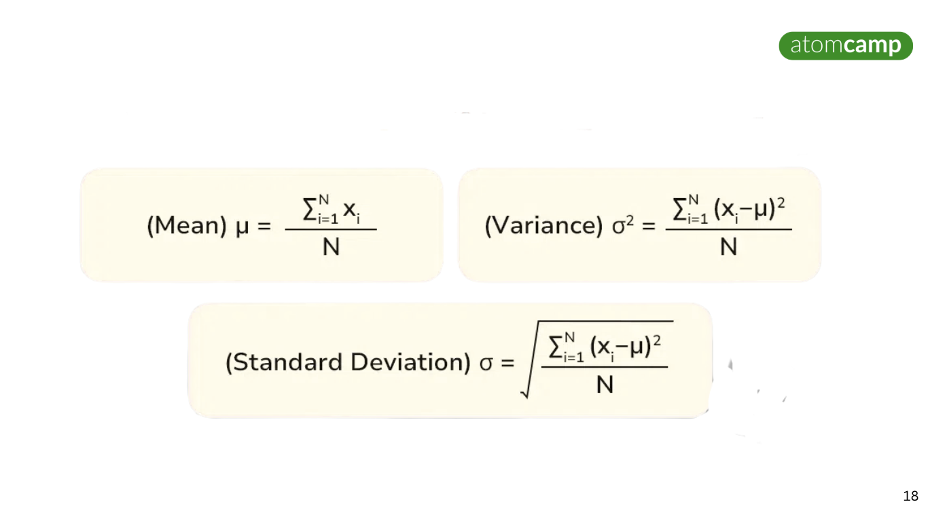

Slide 5
Range
Indicates the spread between the minimum and maximum values in a dataset
Application in Data Science: Provides a simple measure of variability, useful for identifying data outliers
Example:
Product prices: $50, $100, $200, $500
Range = $500 - $50 = $450
Why It’s Important: Helps identify the range of possible values in a dataset, which is critical in data cleaning and exploration
17

Slide 6
Variance
Measures the average squared deviation from the mean.
Application in Data Science: Critical for understanding the consistency or variability of data
Example:
Monthly sales: $10, $20, $30
Mean = $20, Variance = 66.67
Why It’s Important: Used to assess how much a dataset differs from the mean, essential for modeling and risk analysis
18

Slide 7

Standard Deviation:
The square root of variance, providing a measure of spread in the same units as the data
Application in Data Science: Used for assessing the precision of data and model performance
Example:
Monthly sales: $10, $20, $30 ; Mean = $20, Variance = 66.67
(The sales figures deviate from the mean by $8.16 or $8)
Why It’s Important: Helps evaluate model predictions, risk assessment, and data precision
19

